Slide 1
DEVICE TREE SOURCE
Team 8: Complex Driver Presented by: Ashritha and Sujitha

Slide 2
INTRODUCTION
DTS is a human-readable text file that describes the hardware configuration of an embedded system.
It is part of the Device Tree infrastructure, which allows the Linux kernel to understand the hardware layout of a specific platform without hardcoding it into the kernel source.
Enables a common kernel to support multiple hardware platforms.

Slide 3
DTS (Device Tree Source):
A human-readable source file (.dts) that describes about hardware.
Compiled into a binary Device Tree Blob (.dtb) using the Device Tree Compiler (DTC).
DTS Components:
Nodes: Represent hardware components.
Properties: Describe configuration or settings for nodes.

Slide 4
WHY USE DTS?
Advantages:
Simplifies hardware configuration.
Allows the same kernel to support different platforms.
Makes the kernel cleaner by removing hardware-specific code.
Use Cases:
Embedded systems like Raspberry Pi, BeagleBone, etc.
Custom hardware platforms.

Slide 5
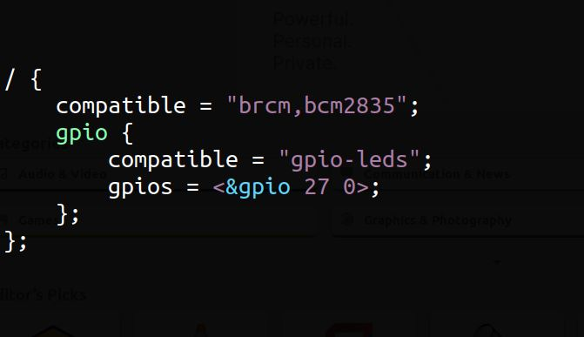
BASIC STRUCTURE
Root Node (/): Represents the system's top level.
Child Nodes: Defines specific devices (eg: GPIO, SPI, I2C).
Properties: Key-value pairs inside nodes.
Example:

Slide 6
property :compatible
Every node in the tree that represents a device is required to have the compatible property.
The link between the hardware and its driver.
Decides which device driver to bind to a device.
compatible= "<manufacturer>,<model>"

Slide 7
NODE IN DTS
Every device in the system is represented by a device node.Node
Names: <name>[@<unit-address>]
In DT, a node has been added for each device in the system, and the hierarchy reflects the how devices are connected to the system
A node in the device tree can be uniquely identified by specifying the full path from the root node

Slide 8
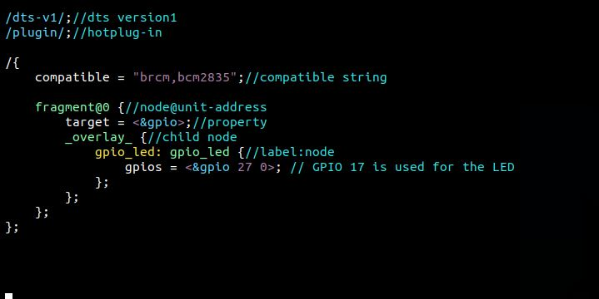
CODE: DTS USING GPIO

Slide 9
Device Tree APIs
of_find_node_by_name(): Find a node by name.
of_get_property(): Retrieve a property.
of_get_named_gpio(): Get a GPIO number.
of_find_compatible_node(): Find a node by compatibility.

Slide 10
COMPILATION STEPS
Compile the Device Tree Overlay:
To compile the Dts into a binary .dtbo file (Device Tree Overlay), run the following command: dtc -@ -I dts -O dtb -o gpio_led.dtbo gpio_led.dts
Load the Device Tree Overlay:
Copy the gpio_led.dtbo file to the /boot/overlays/ directory: sudo cp gpio_led.dtbo /boot/overlays/
You can load the overlay via the /boot/config.txt file by adding the following line: dtoverlay=gpio_led
Alternatively, you can load the overlay dynamically using the following command: sudo dtoverlay gpio_led
Compile and Test the Kernel Module:
sudo insmod gpio_led.ko and then check dmesg it shows: [ 124.567890] LED GPIO found: 17 and sudo rmmod gpio_led.ko and check dmesg [ 124.567899] GPIO LED driver loaded.
When the module is inserted, the LED connected to GPIO 17 will turn on for 1 second and then turn off. The kernel logs will display messages confirming the operations.

Slide 11
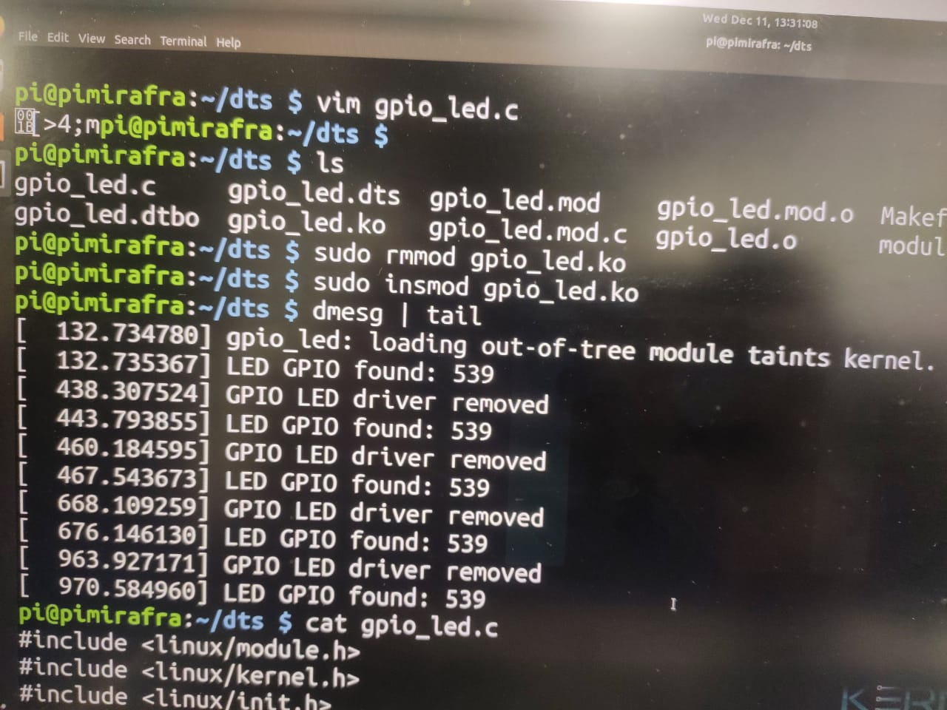
OUTPUT

Slide 12
Practical applications
Board support package(BSP): used in embedded systems to describe the hardware of specific board.
Custom Hardware: Developers creating custom boards must write or modify DTS files to describe their hardware to the linux kernel.

Slide 13


